Slide 1

Education Consultancy System: Streamlining Educational Guidance

Slide 2

Our Team
Meehir Lokhande
Pothu Chandana
Srikowndinya Pedasanaganti

Slide 3
Introduction
The Edu Consultancy System is a seamless, user-friendly platform designed to streamline communication and planning between students, parents, and educational consultants.
With intuitive navigation, users can easily explore and manage courses in collaboration with consultants, ensuring a smooth and efficient experience for both students and service providers.
This smart solution empowers students to make well-informed decisions about their education, while consultants and administrators gain powerful tools to optimize planning and training programs.

Slide 4
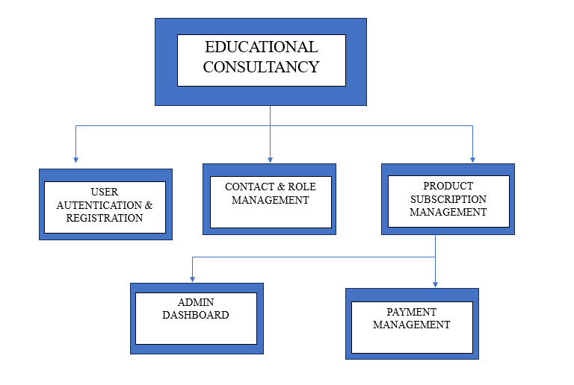
Modules Overview
User Registration & Authentication
Contact & Role Management
Product Subscription Management
Payment Management
Admin Dashboard

Slide 5
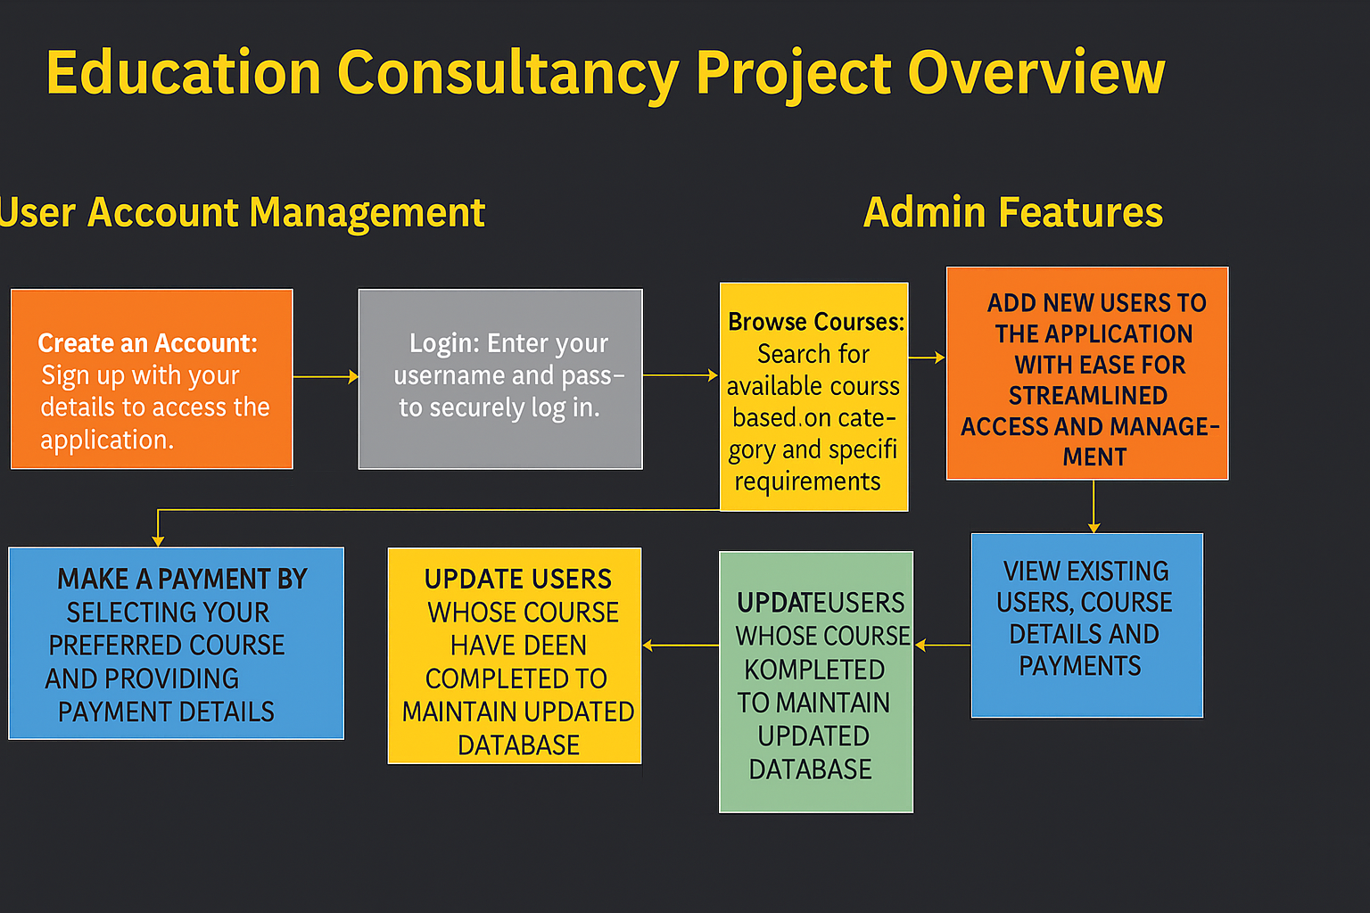
Project Overview

Slide 6
User Account Management
Create an Account: Sign up with your to access the appdetailslication.
Login: Enter your username and password to securely log in.
Browse Courses: Search for available courses based on category and specific requirements.
MAKE A PAYMENT BY SELECTING YOUR PREFERRED COURSE AND PROVIDING PAYMENT DETAILS

Slide 7
Admin Features
LOGIN WITH THE APPLICATION TO MANAGE THE USERS.
ADD NEW USERS TO THE APPLICATION WITH EASE FOR STREAMLINED ACCESS AND MANAGEMENT.
MANAGE PAYMENT DETAILS OF THE USERS,ENSURING ACCURATE PROCESSING AND RECORDS.
VIEW EXISTING USERS, COURSE DETAILS AND PAYMENTS
UPDATE USERS WHOSE COURSE HAVE BEEN COMPLETED TO MAINTAIN UPDATED DATABASE.

Slide 8
Requirement Specification:
SOFTWARE REQUIREMENTS
Frontend – React.js, CSS, Bootstrap
Backend – Java, Springboot3
IDE – Eclipse, VsCode
Database - MySQL
Browser - Chrome, Safari

Slide 9
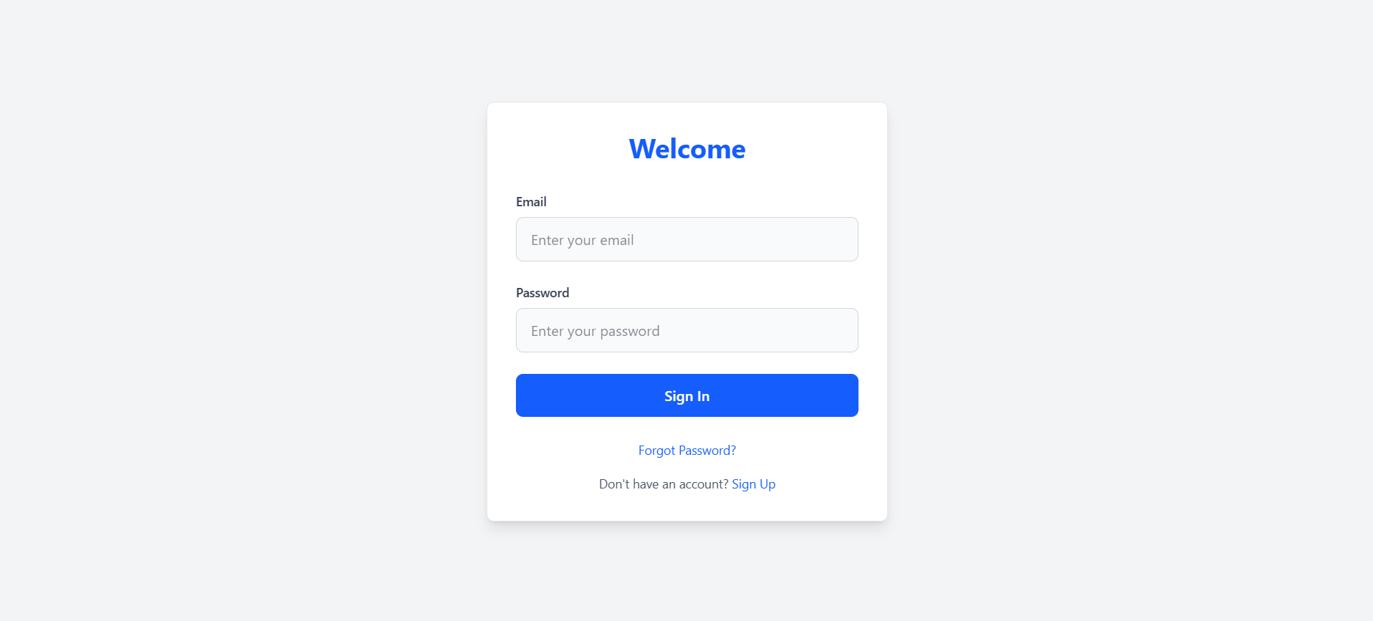
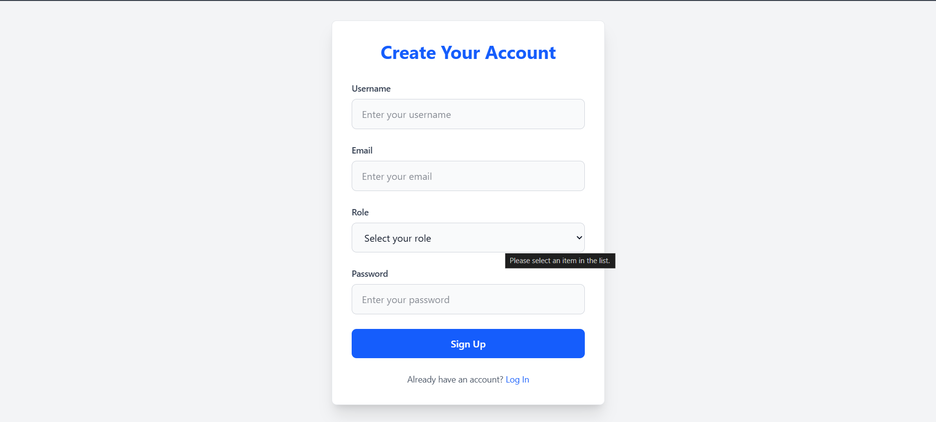
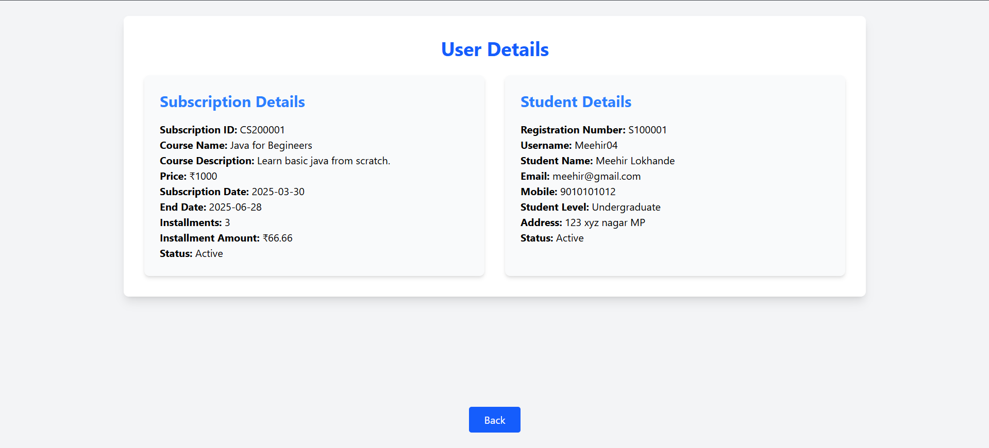
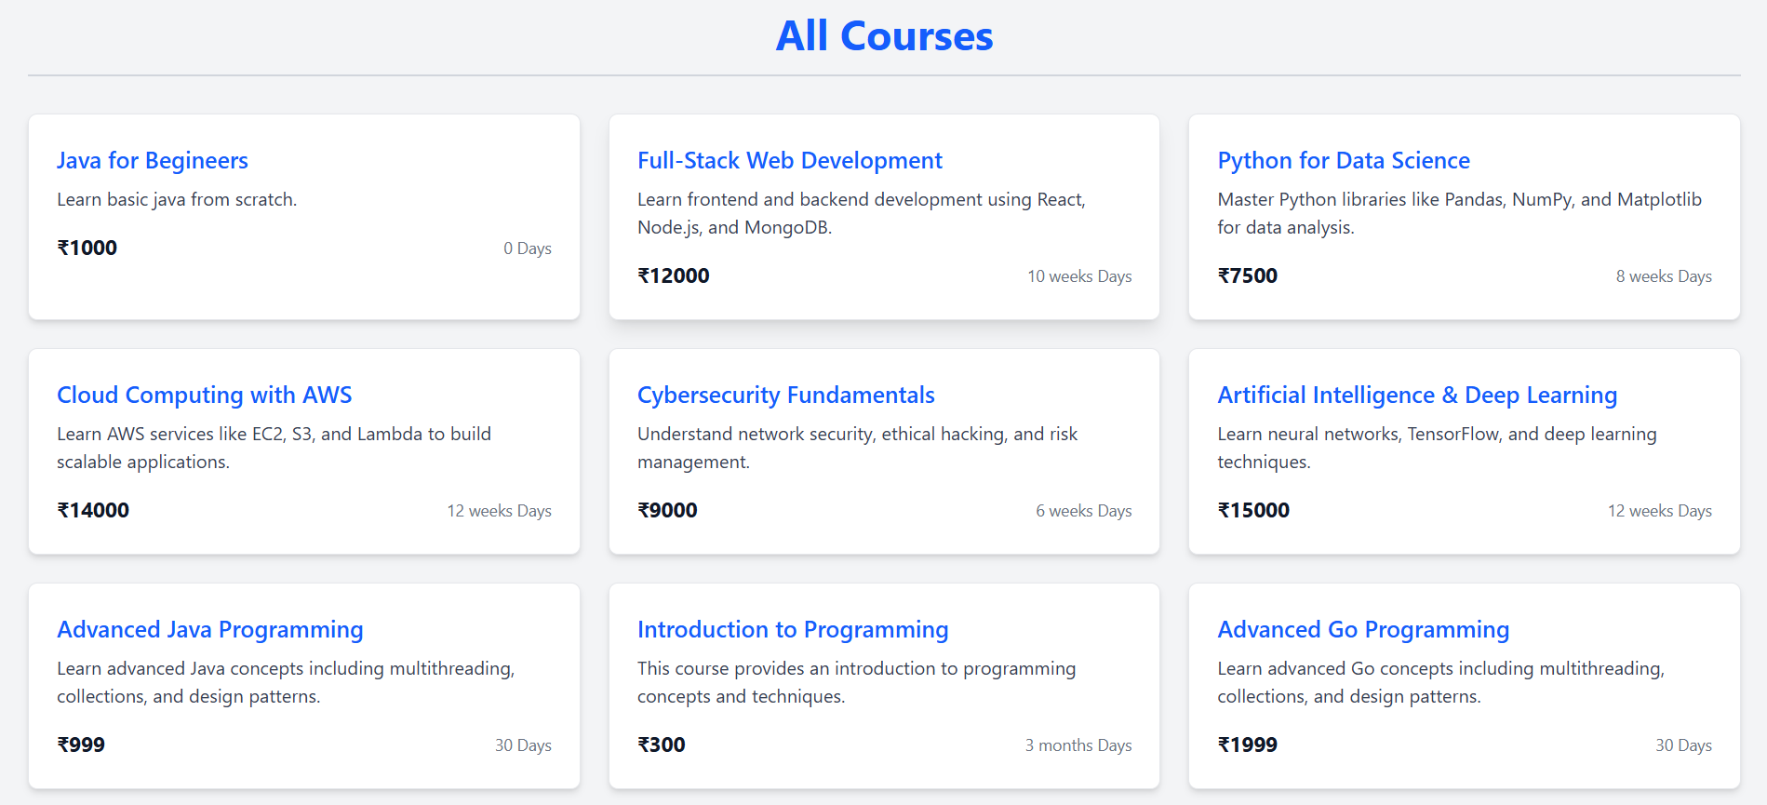
Sign in Page
Signup Page
Admin User Details
Admin All Courses

Slide 10

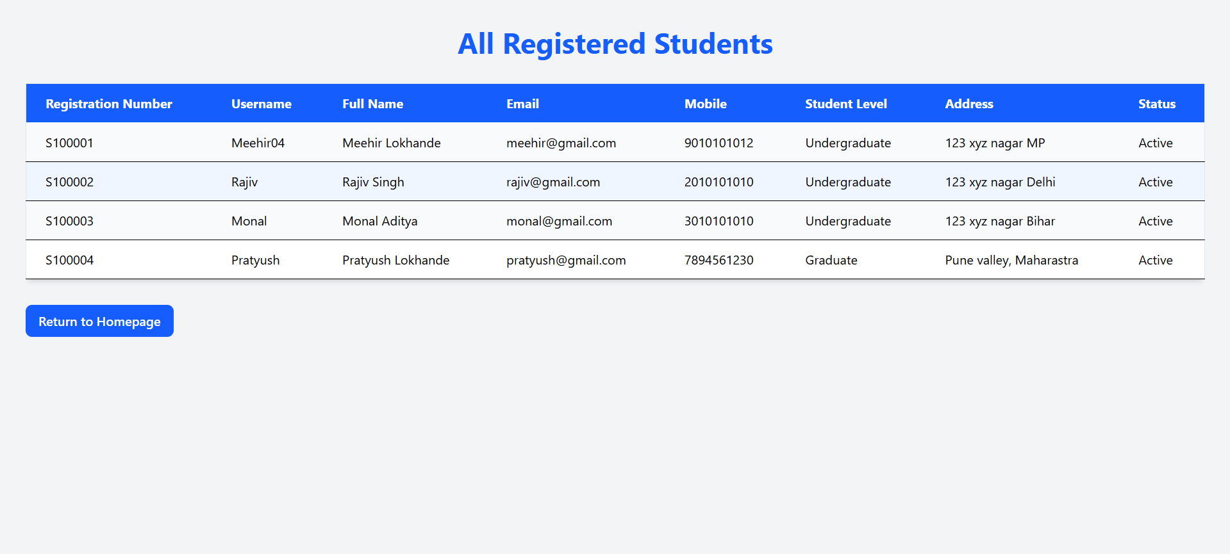
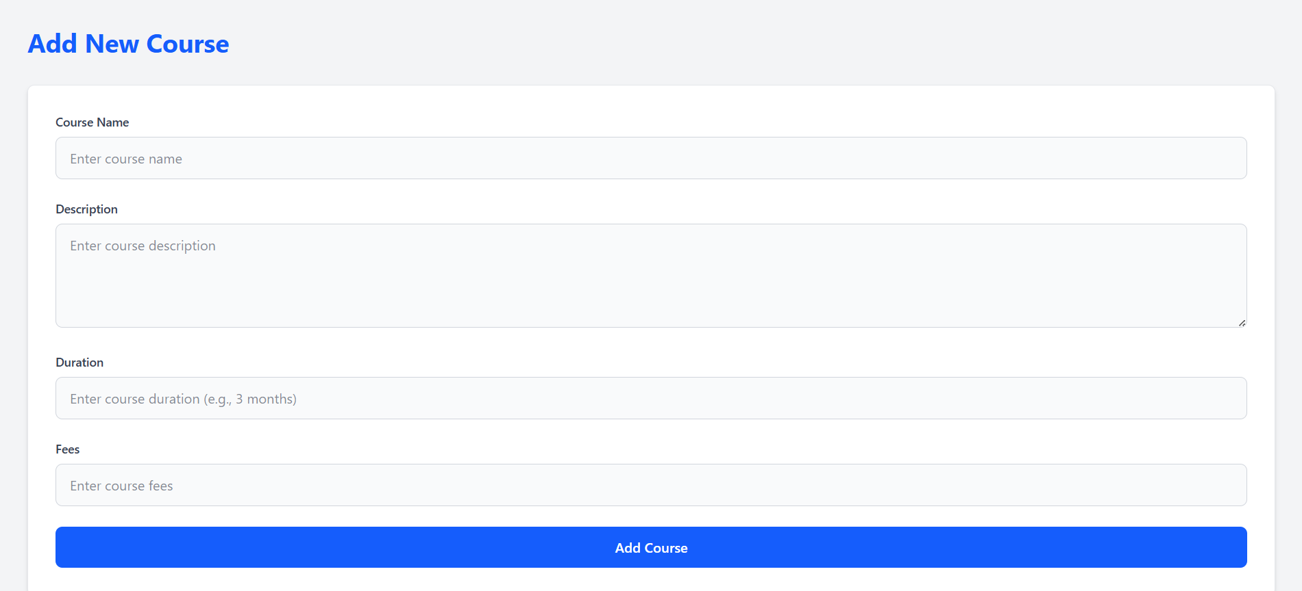
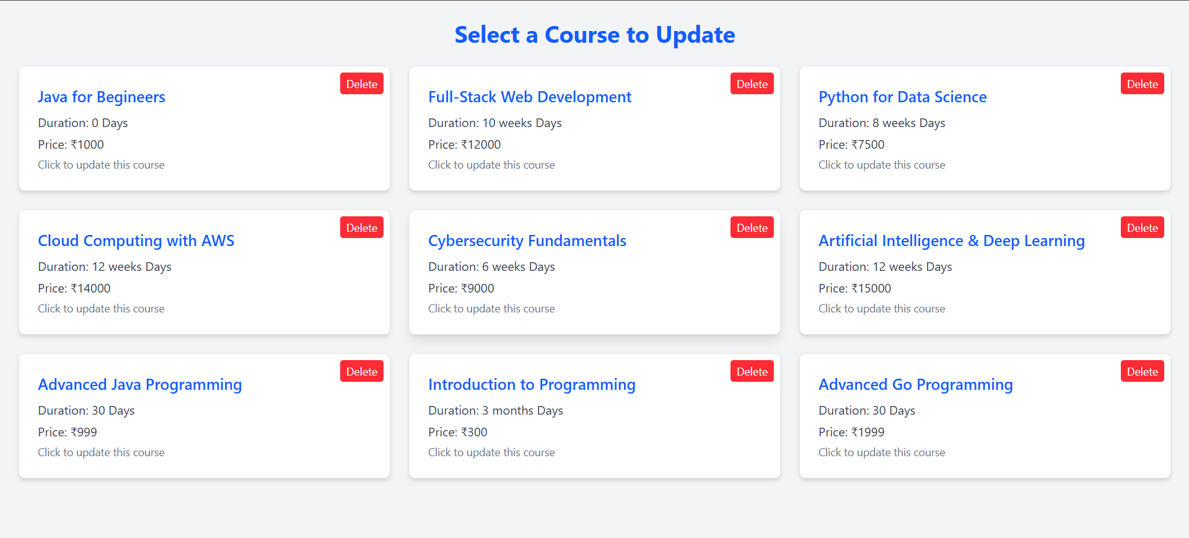
Admin Dashboard
All Registered Students
Update Course Details
Course Addition
The Edu Consultancy System requires specific hardware configurations to ensure optimal performance and reliability. These minimum hardware requirements guarantee that the system functions smoothly and efficiently for all users.

Slide 11
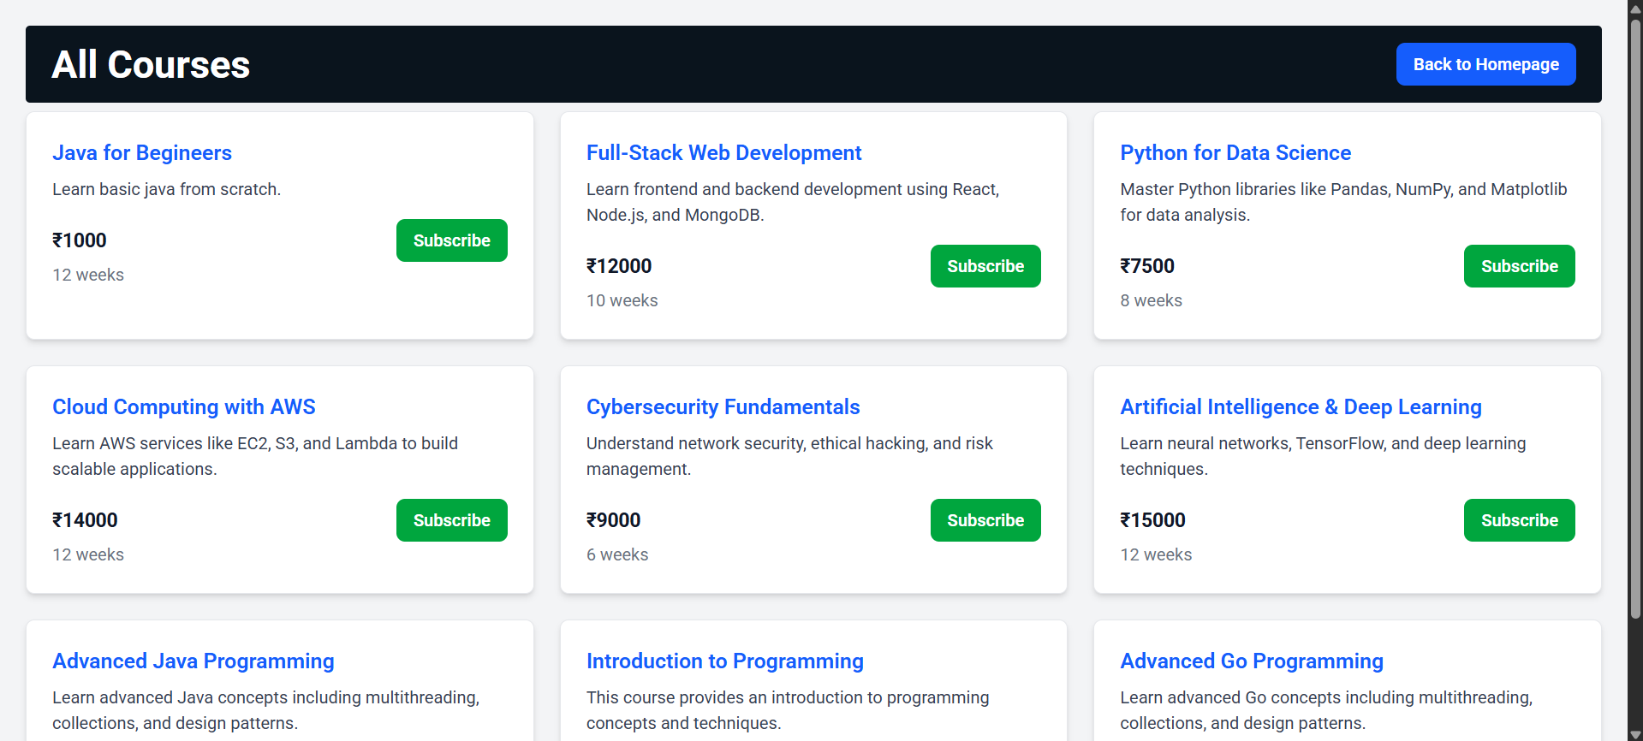
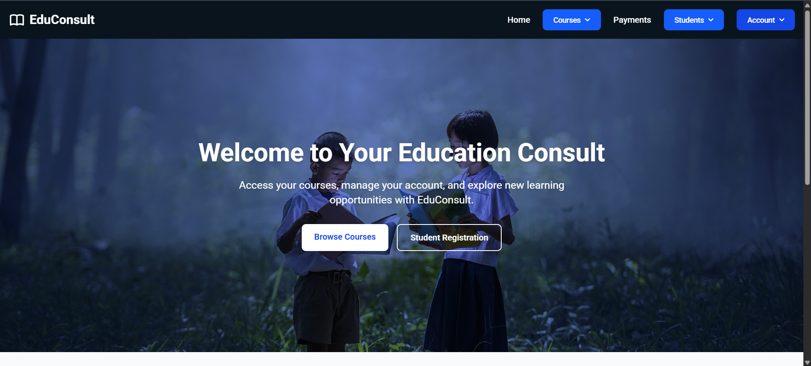
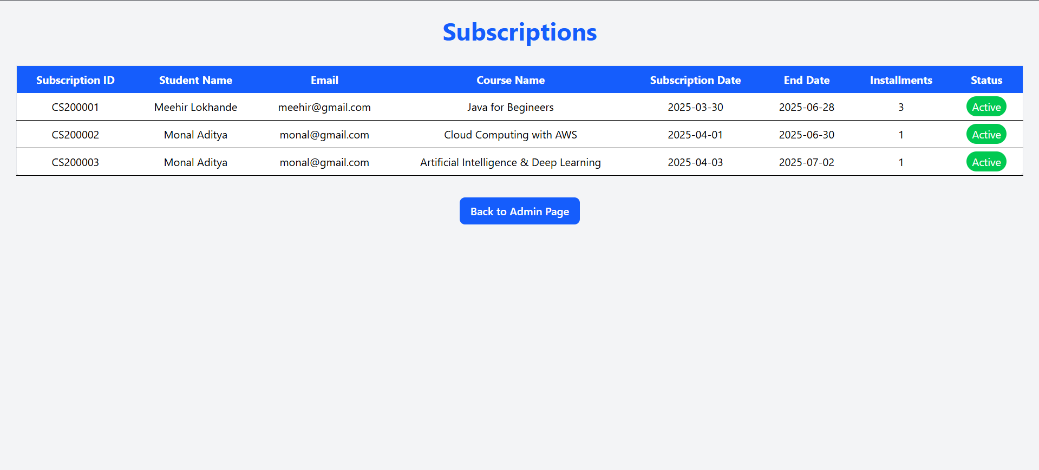
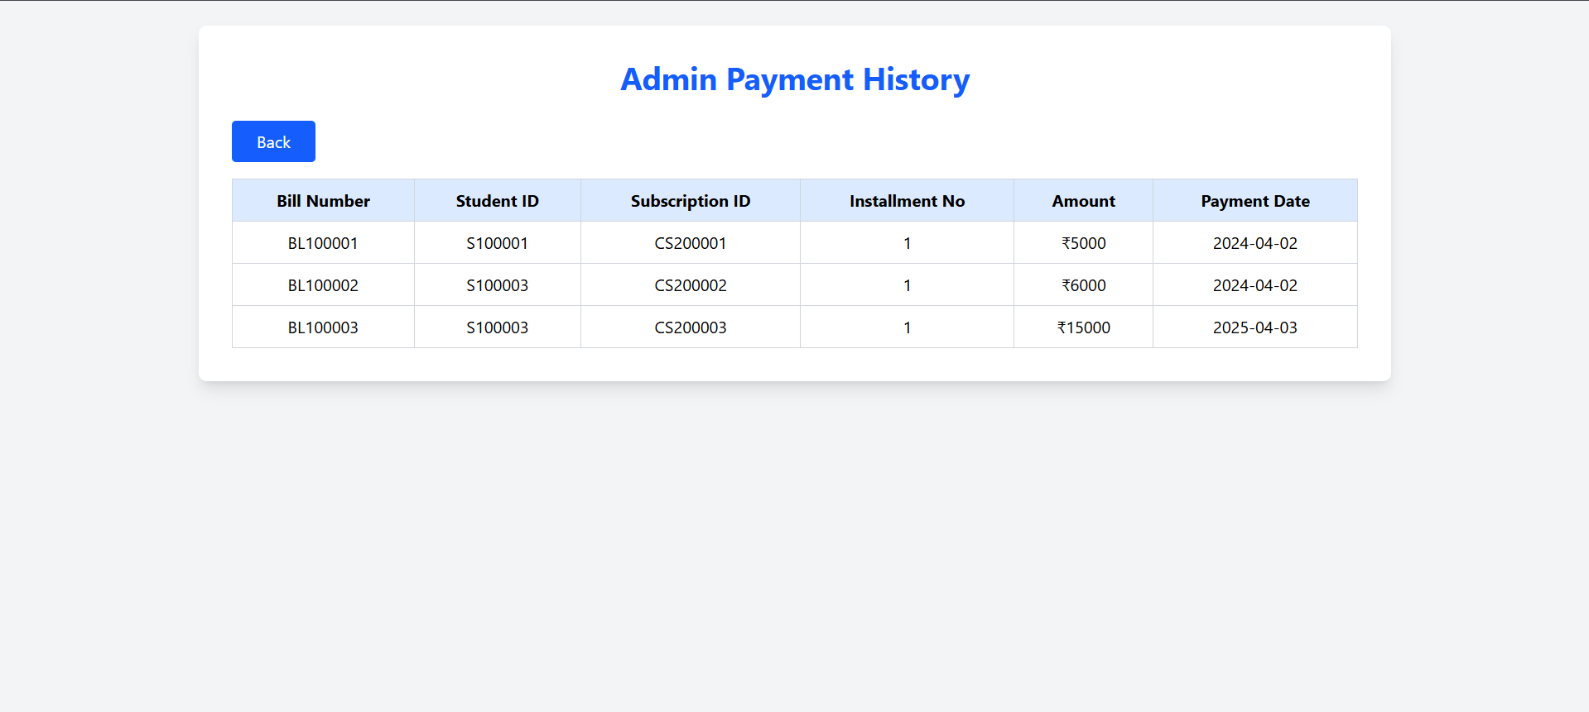
User’s Homepage
Student All Courses
Admin Subscription Page
Admin Payment History

Slide 12
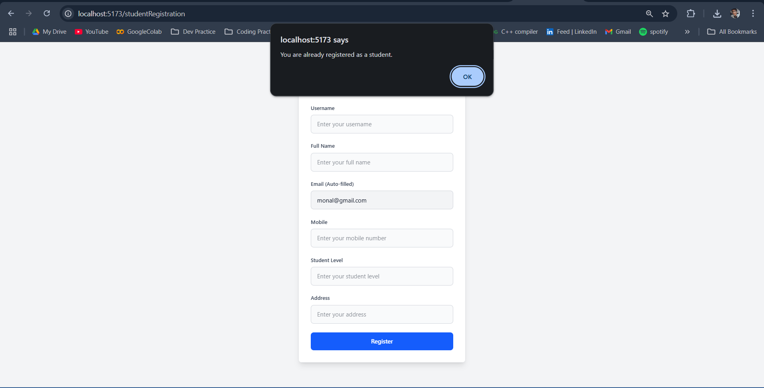
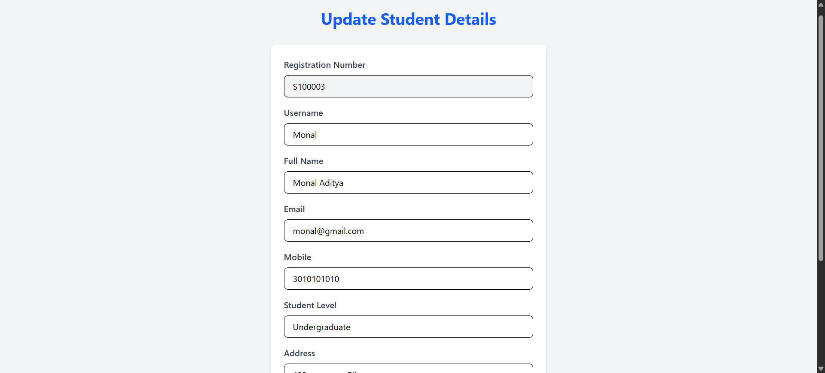
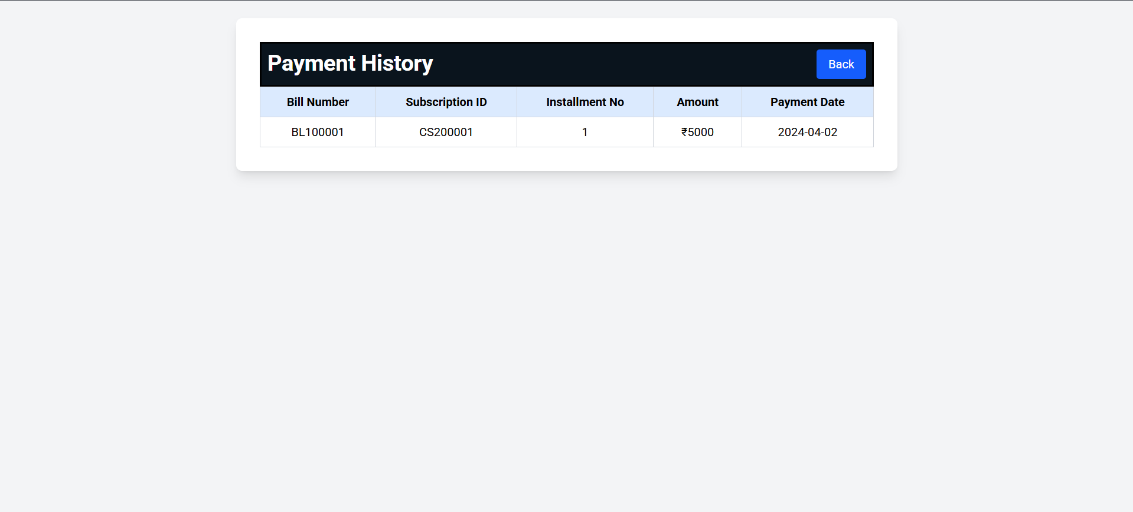
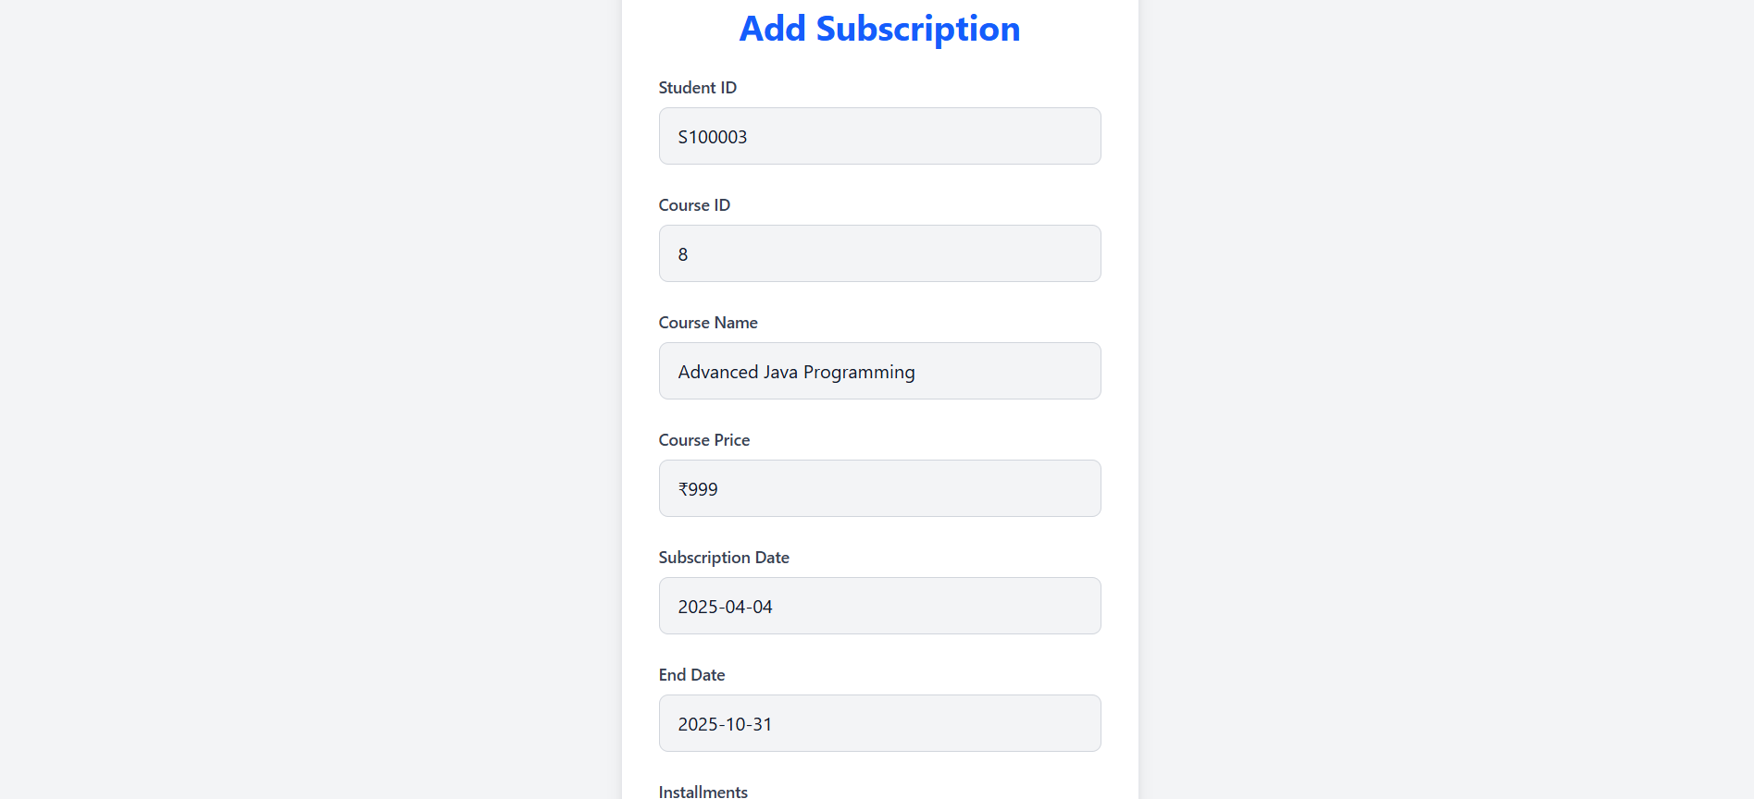
Student Registration
Edit Student Details
Student Payment History
Student Add Subscription

Slide 13

Future Enhancements:
Add the AI Chatbot feature to increase user’s engagement.
Make UI better and user friendly.
Add blogs section.

Slide 14

Conclusion: A Seamless Educational Platform
The Edu Consultancy System is a comprehensive solution designed to streamline educational planning and guidance for students and admin.
Students can create accounts, manage subscriptions with ease. Administrators can manage user data, payments, and monitor subscription statuses through a dedicated dashboard.
The system enhances user experience with automated notifications, role-specific dashboards, and blogs content, making it a seamless and efficient platform for educational consultation

Slide 15
Thankyou!!

